Slide 1
Introduction to the Microsoft Band
Ian Philpot
Sr. Technology Evangelist

Slide 2


Slide 3
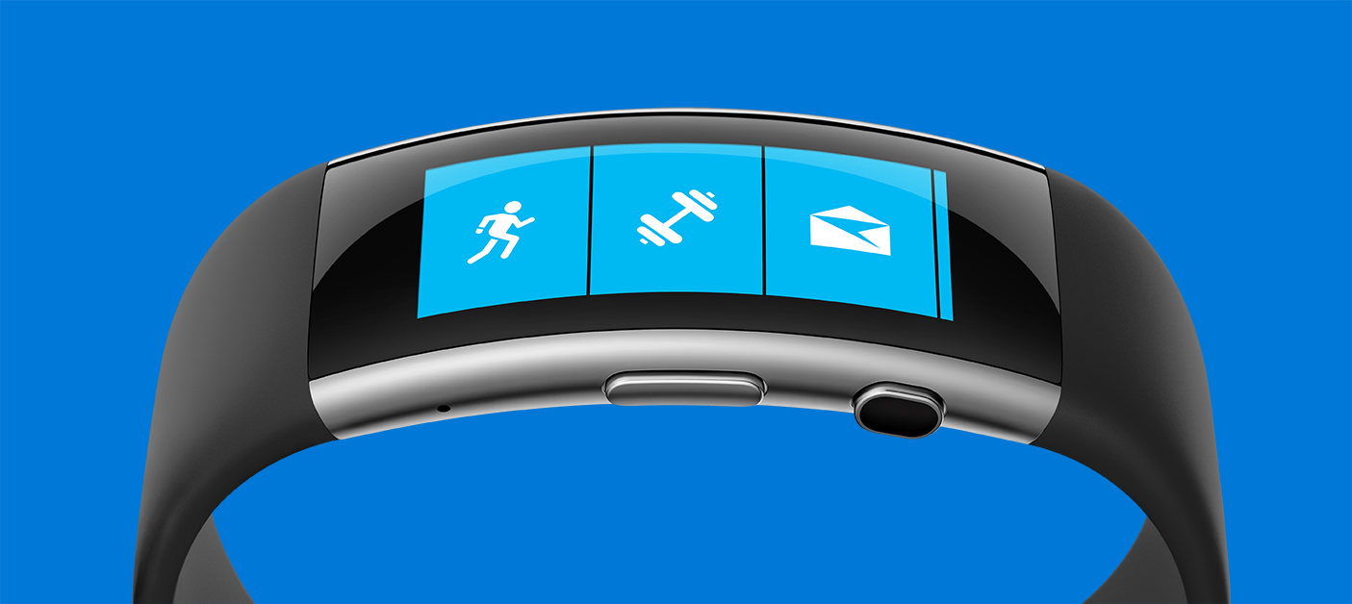
This is Microsoft Band

Slide 4

Live Healthier

Slide 5
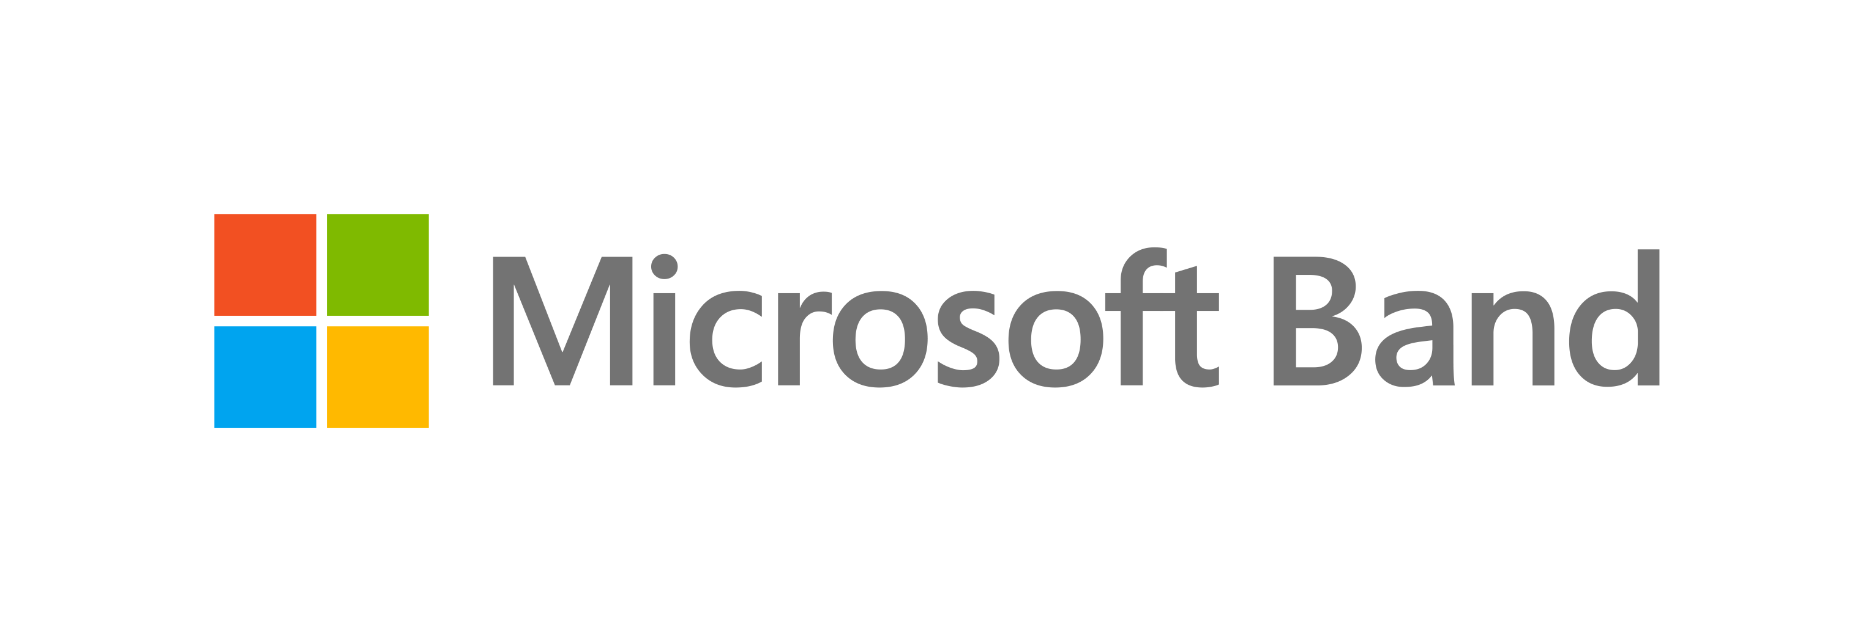
Microsoft Health
Set wellness goals and get actionable insights to help you live healthier.
Continuous optical heart rate monitor
Understand more about your overall fitness when you can track your heart rate 24 hours a day.
Sleep quality
Analyze your light and restful sleep, your sleep restoration and sleep efficiency, and number of wake-ups each night.
Notes:
Microsoft Health
Set wellness goals and get actionable insights to help you live healthier. Microsoft Health combines your fitness data with the power of the cloud giving you actionable, personalized insights, empowering you to live healthier and achieve more. Analyze your data in full-color, easily-understandable charts and graphs in the convenient phone app or the robust web dashboard.
Continuous optical heart rate monitor
Understand more about your overall fitness when you can track your heart rate 24 hours a day. Know the boundaries of your heart rate zones, from your maximum heart rate during exercise to your resting heart rate during last night’s sleep.
Sleep quality
Everyone wants a better night’s sleep. Analyze your light and restful sleep, your sleep restoration and sleep efficiency, and number of wake-ups each night with full-color, easily-understandable charts in the Microsoft Health app and web dashboard.
UV monitoring
Stop guessing when it’s time to apply sunscreen. Get a real-time reading of your UV exposure.
Exercise recovery
Don’t work out in vain. Microsoft Health will recommend how much time your body needs to recover before your next workout.
App compatibility
Microsoft Band is fully compatible with popular fitness apps like Strava, MapMyRide, MyFitnessPal, Runkeeper, and MapMyFitness.
Calorie tracking
Measure the calories you burn each day. With Microsoft Health, you’ll see how many calories you burn with each workout, giving you greater understanding of which activities earn you the biggest burn.
Goal Keeper
Set goals and track your performance with the robust Microsoft Health app. Microsoft Band notifies you when you meet your goals so you can stay motivated.

Slide 6

Healthier living is easier with Microsoft Band

Slide 7

Get Fit

Slide 8
Run
Track your heart rate, calorie burn, splits, average pace, and personal bests.
Bike
Deliver insights specifically tailored for bike rides both indoors and out.
Golf
GPS detects which hole you’re playing, shot tracking manages your scorecard.
Guided Workouts
Expert-designed workouts and track your reps and calories burned.
Notes:
Run
With the built-in GPS, Microsoft Band is your perfect running companion. Whether you’re on the treadmill or outdoors, you can view your run summary on your band, including heart rate, calorie burn, distance, splits, elevation gained, and instantaneous and average pace. Go to the Microsoft Health app for a recorded map of your last run, and metrics like pace splits and average pace. In the Microsoft Health web dashboard, you can analyze your data to find specific aspects of your runs you can improve, and compare your personal bests. Connect with your favorite running apps like Runkeeper, MapMyRun, and Strava.
Bike
Microsoft Band sensors measure your heart rate during bike rides, and deliver insights specifically tailored for bike rides both indoors and outdoors. Track speed, distance, and elevation gained with a built-in barometer. Share your ride map with your riding buddies in email or on Facebook and Twitter. Connect with your favorite cycling apps like Strava, MapMyRide, and MapMyFitness.
Golf
Put away your phone and track your golf game and your health right on your wrist with Microsoft Band and TaylorMade®. The built-in GPS detects which hole you’re playing and provides you with distance to the front, center, and back of the green, allowing you to perfect your approach. You can focus on your golf game rather than your scorecard with automatic shot tracking. While you play, your band notifies you about important texts, emails, and calls, and tracks your strokes, steps, heart rate, and calorie burn. After your round, Microsoft Health helps you analyze your fitness benefits and game stats while TaylorMade’s MyRoundPro provides even deeper game analysis.
©2015 TaylorMade Golf Company, Inc. All Rights Reserved. TaylorMade®, adidasGolf and Ashworth® are brands of Taylor Made Golf Company, Inc., part of the Adidas Group
Guided Workouts
Guided Workouts are workout routines you download to Microsoft Band. Your band will tell you what exercise to do, and can track your reps and calories burned. Browse the Microsoft Health mobile app or web dashboard for workouts designed by fitness professionals from Gold’s Gym, Shape Magazine, and Men’s Fitness, or customize workouts for yourself. You can make edits to any Guided Workout before you download it to your band—for example, add reps, remove squats, or add more time to a warm-up. You can also design your own workouts from scratch.
Floors climbed
Get credit for taking the stairs. Track the number of floors you climb and find out how many calories you burn for the effort.
Exercise
Track your heart rate, duration, and calories burned during your favorite exercise. Whatever workout you feel like doing today, go for it—track your progress during group fitness classes, bodyweight or strength training, and even yoga.
Steps
Count your steps every day, set a daily goal, and track your progress. Microsoft Band calculates the calories you’ve burned and the distance you’ve traveled each day.

Slide 9
Reach your fitness goals with custom tracking

Slide 10
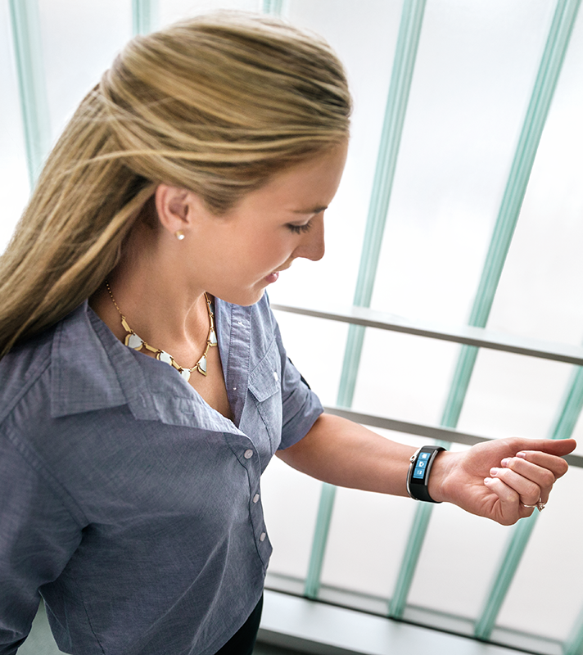
Be Productive

Slide 11
Email previews and calendar notifications
Keep your phone in your pocket while you preview emails and get your calendar notifications on the go.
Receive and reply to text messages
Get text message previews right on your wrist.
Cortana
Reply to text messages, take notes, and set reminders with your voice using Cortana.
Notes:
Email previews and calendar notifications
Always stay in the loop. Monitor and preview emails right on your wrist, and keep your phone in your pocket. Microsoft Band stays in sync with your calendar, reminding you of important events throughout the day.
Receive and reply to text messages
Get text message previews right on your wrist. Reply instantly to texts with a standard quick response like “I’ll call you later,” or create your own set of personal replies in the app. If you have Windows Phone 8.1, you can type responses using a virtual keyboard or dictate responses with your voice, powered by Cortana.
Cortana
Stay productive even when your phone is put away. Reply to text messages, take notes, and set reminders with your voice using Cortana personal assistant if you use Windows Phone 8.1 or later.
Smart alarm
Feel your best in the morning. Set the alarm and your band will wake you up at the optimal time during your sleep cycle up to 30 minutes before the alarm goes off.
Smart notifications
Use the Microsoft Health phone app to select the notifications you get on your band. Choose from texts, calls, calendar reminders, and updates from Facebook and Twitter. To turn off notification alerts, simply tap the Do Not Disturb icon on your band.
Finance
Track your stocks right on your wrist, without pulling out your phone. Create a watch list for select stocks in the Microsoft Health app.
Cross platform compatibility
Whether it’s an iPhone®, Android™, or Windows Phone, Microsoft Band works seamlessly across platforms.
Calls
See incoming calls and voicemail notifications on your band. Reply instantly with a standard quick response like “I’ll call you later” or choose one that you’ve created in the Microsoft Health app. To turn off notification alerts, simply tap the Do Not Disturb icon on your band.
Timer/stopwatch
Time your laps or your entire workout with the stopwatch feature. Set the timer to keep track of time, whether it’s keeping up the intensity for a set duration during your workout or a 15-minute power nap.
Weather
Real-time weather conditions and a 5-day forecast help you plan your week.
Facebook
Stay up to date on Facebook without having to check your phone. Get the latest status updates, comments, and photo notifications on your band.
Facebook Messenger
Keep on top of your personal Facebook messages from friends and family without having to check your phone.
Twitter
Tweets, mentions, retweets, messages, new followers. Set your preferences on your phone and see it all on your wrist.
Social
You can choose how you get alerts from your social channels, like Facebook and Twitter. Change the notification settings on your phone and they will sync onto your Microsoft Band.
Starbucks
No need to reach for your wallet. Pay for coffee on the go with your Starbucks Card ready to scan right from your wrist.
Quick Read
Quick Read helps you read text, email, and other notifications especially when you’re on the go. By rapidly displaying messages one word at a time, your band helps you quickly read a message without the need to scroll.
Instant quick response does not work with iPhone.
Cortana only available with Windows Phone 8.1 update or later, available in English only.
Works with Windows Phone 8.1 update or later, iPhone® 5 or later running iOS® 8.1.2 or later, and Android™ 4.4 or later phones, with Bluetooth. Cortana only available with Windows Phone 8.1 update or later, available in English only.
Instant quick response does not work with iPhone.

Slide 12
Stay connected at a glance

Slide 13
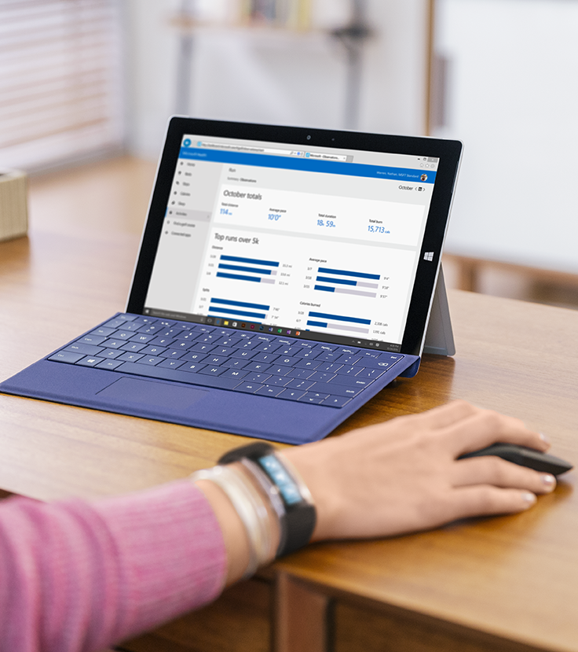
Advanced Technology

Slide 14
Microsoft health
Set wellness goals and get actionable insights.
Built-in GPS
When you run or bike, you’ll get a map of your route in the mobile app and web dashboard.
Barometer
Built-in barometer that measures elevation changes while hiking, biking, or just climbing stairs.
UV Monitor
Determine if you need sunscreen with a built-in UV monitor.
Notes:
Microsoft Health
Set wellness goals and get personal insights to help you achieve them. By combining your fitness data with the power of the cloud, Microsoft Health gives you real-time, valuable insights into your fitness today that will guide you towards healthier living. Microsoft Health delivers valuable, personalized fitness insights, empowering you to lead a healthier life. Access your personal charts through the convenient phone app or the robust web dashboard.
Built-in GPS
Put away your phone or GPS device and concentrate on your golf game or your workout. While golfing, the built-in GPS on your band calculates distances on the course, including the distance to the front, center, and back of the green. And when you run, bike, or hike, it records your route and maps it in the Microsoft Health app and web dashboard.
Barometer
Track your fitness with more precision with a built-in barometer that measures elevation changes while hiking, biking, or just climbing stairs.
UV monitor
Your band can notify you when your UV exposure is more than 2 on the UV index. Set a notification alert or get a real-time reading any time.
Modern design
Beautiful, modern design and cutting-edge technology come together. The satin steel finish is durable, modern, and stylish. The slim profile, flexible arms, and curved display fit your wrist naturally and comfortably.
UV monitor
Stop guessing when it’s time to apply sunscreen. Your band can notify you when your UV exposure is more than 2 on the UV index. You choose whether or not you want a notification, and how often. Get a real-time reading of your UV exposure at any time by tapping the UV Tile.
Curved touchscreen
The curved touchscreen fits your wrist naturally and comfortably.
AMOLED display with Corning® Gorilla® Glass 3
The vibrant, full-color AMOLED display is bright and easy to read, and comes with durable Corning® Gorilla® Glass 3 to help protect it.
Watch Mode
Set the display on Microsoft Band to always display the time, or only when you rotate your wrist.
Battery life
Get up to two days from Microsoft Band with normal use. If using the GPS, increasing display brightness, and working out multiple times a day, you’ll need to recharge more frequently. A 30-45 minute charge will get you through your day. A full charge takes about 2 hours.
Bluetooth 4.0
With Bluetooth 4.0, your data syncs to your phone in the background, so Microsoft Band is always up to date. You don't have to log in to get the latest.
Water resistance
For limitations on water resistance and details, see microsoft.com/band/waterresistance.
Battery has limited recharge cycles and cannot be replaced. See microsoft.com/band/battery.
Battery has limited recharge cycles and cannot be replaced. See microsoft.com/band/battery.

Slide 15
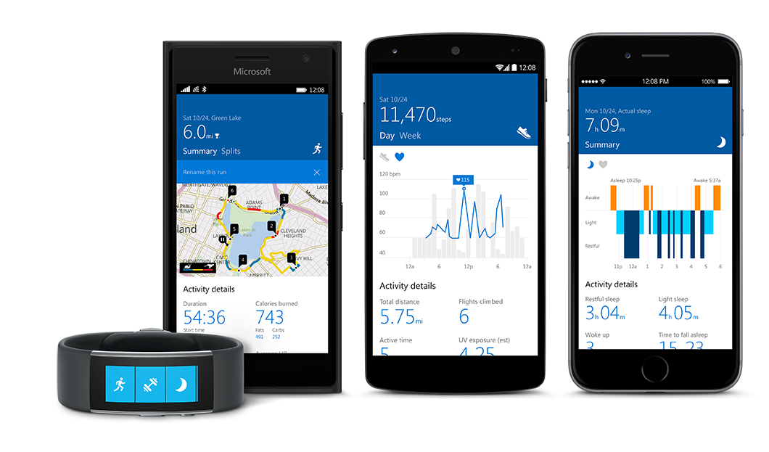
Microsoft Band SDK
http://developer.microsoftband.com/
Supports Windows, Android, iOS

Slide 16
Microsoft Band SDK Code Ex.
IBandClient bandClient = await BandClientManager.Instance.ConnectAsync(bands[0]))
bandClient.SensorManager.Accelerometer.ReadingChanged += Accelerometer_ReadingChanged;
await bandClient.SensorManager.Accelerometer.StartReadingsAsync();

Slide 17
Eleven sensors on Microsoft Band

Slide 18
Robot Demo

Slide 19
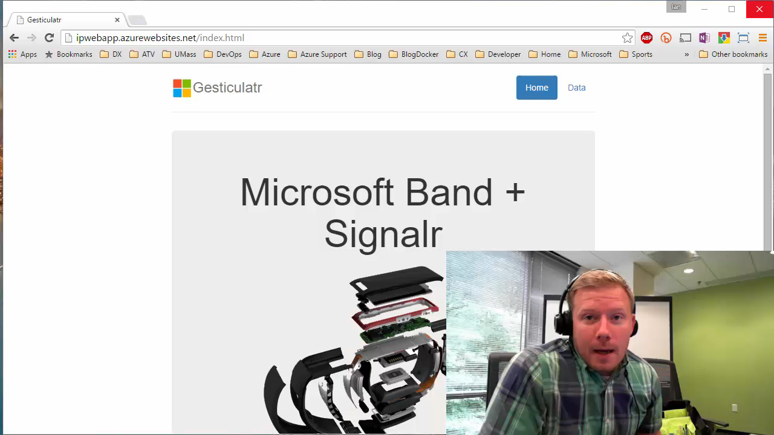

Slide 20
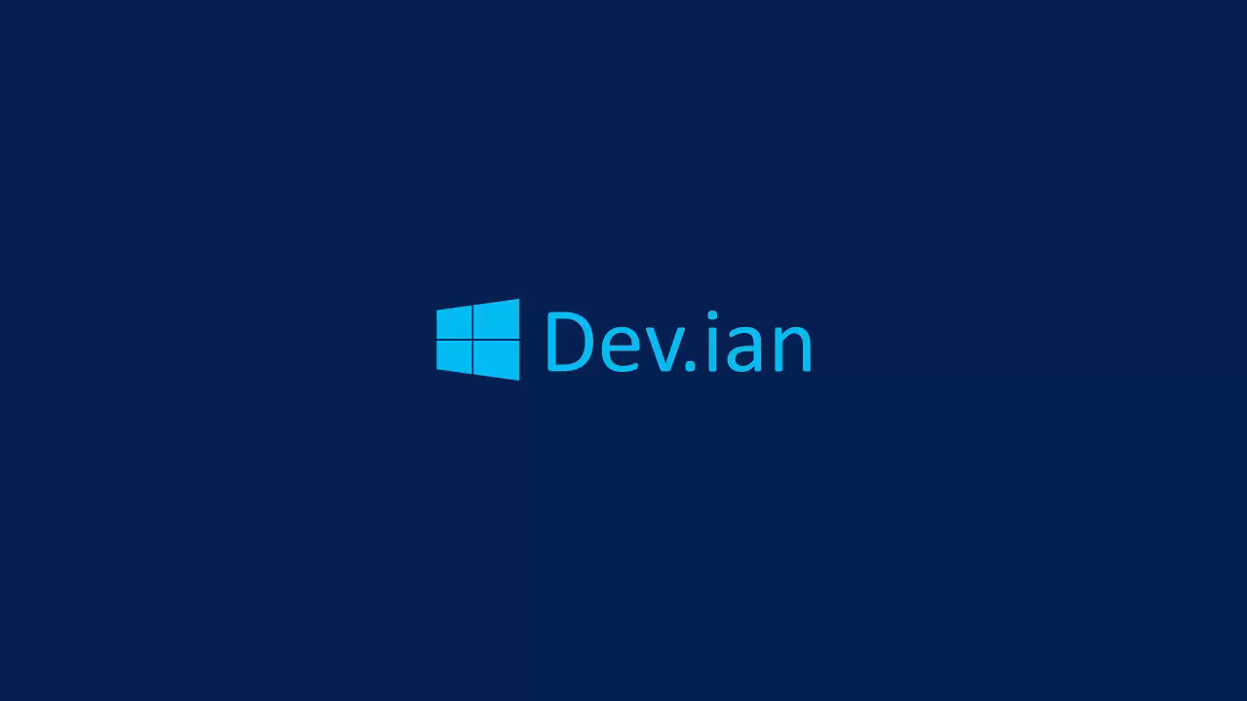

Slide 21
Visual Studio Demo

Slide 23
Preferred text layout (no bullets)
Main topic 1: size 40pt
Size 20pt for the subtopics
Size 20pt for the subtopics
Main topic 2: size 40pt
Size 20pt for the subtopics
Size 20pt for the subtopics
Main topic 3: size 40pt
Size 20pt for the subtopics
Size 20pt for the subtopics

Slide 24
Bullet points layout with subtitle Subtitle
Example of a bulleted slide with a subhead
Set the slide title to “Sentence case”
Set subheads to “Sentence case”
Hyperlink style
www.microsoft.com

Slide 25
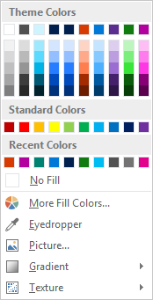
Slide palette info
The PowerPoint palette for this template has been built for you and is shown below. Avoid using too many colors in your presentation.
Select the 4th color from the left for subheads and 1st level non-bulleted text color, or wherever “color” text is preferred over the default black/white text
Accent colors 1-6 – (6 Theme Colors to the far right)
Text
Dark 2
Accent 1
Accent 2
Accent 3
Accent 4
Accent 5
Accent 6
Use Accent 1 as the main accent color. Use Accent 2 and Accent 3 when additional colors are needed.
Use Accents 4-6 sparingly – only when more colors are necessary.

Slide 26
Section title

Slide 27
Photo layout 1

Slide 28
Software code slide
This slide layout uses Consolas, a monotype font which is ideal for showing software code.

Slide 29
Notes (hidden)
Some speakers at Microsoft like to use this slide for hidden “notes slides”.
Delete it if you don’t want to use it.
NEXT: <next slide title>

